Slide 1
Project 3: Capital Asset Pricing Model
MAL 4330 – INTRODUCTION TO FINANCIAL ENGINEERING​
Group - 7

Slide 2
Background
We have taken the 91-days GOI Treasury Bill as Risk-free asset.
We have taken 10 stocks of various Indian Companies listed on NSE and did the Markowitz Portfolio Optimization.
Created Markowitz bullet and efficient frontier.
Calculated expected return, CML using Capital Asset Pricing Model (CAPM).
Calculated SML for individual stocks.
Compared the performance of stocks and portfolio using Sharpe ratio.

Slide 3
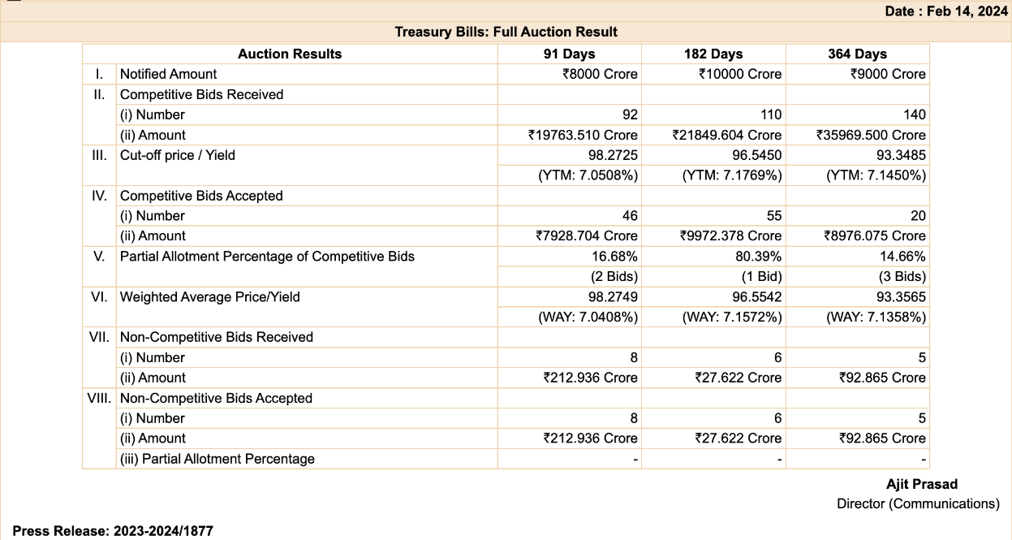
Risk-free Asset
Source :- https://rbi.org.in/Scripts/BS_PressReleaseDisplay.aspx?prid=57327
We have taken the press release of treasury bills allotment announcement dated Feb 14, 2024. The "Yield" for all type of bills (91 days, 182 days and 364 days) is roughly around 7.1% p.a. (YTM). We will be going ahead with 91 days bill in this project, with yield = 7.05% p.a.
(1 + U_rf)³⁶⁴ = 1 + r_eff => U_rf = 0.00018

Slide 4
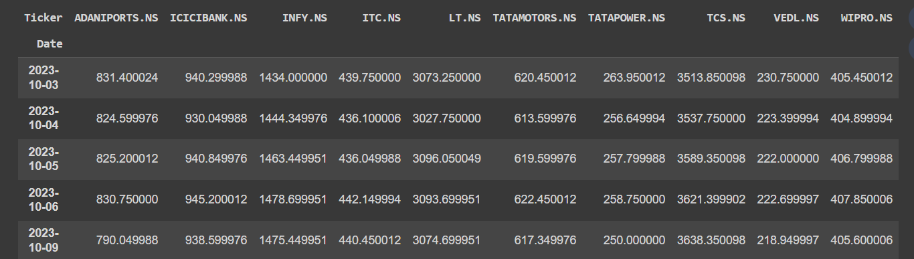
Risky Assets
We have used yfinance library and imported 10 stocks’ closing price for a period of 3 months.
The stocks we have chosen are :-
Did the pre-processing of the data
Calculated simple returns with these closing prices and plotted them.

Slide 5
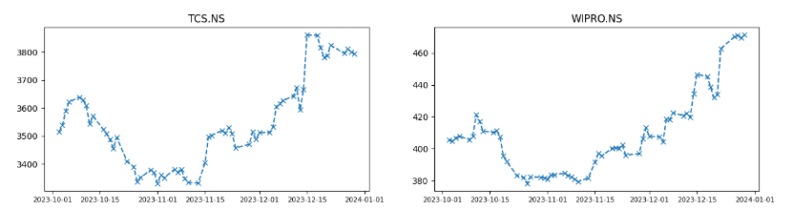
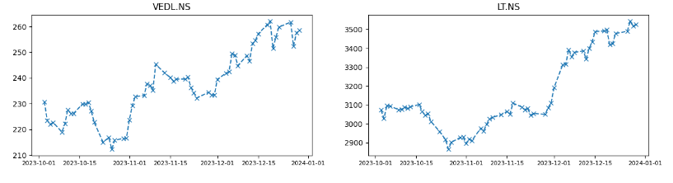
Closing Prices Plots

Slide 6
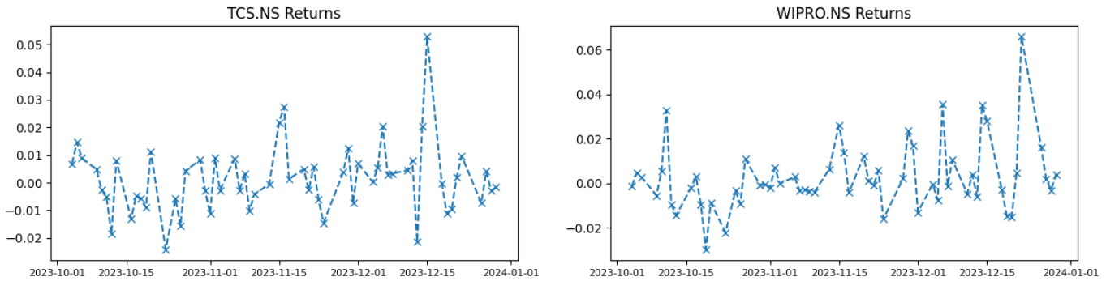
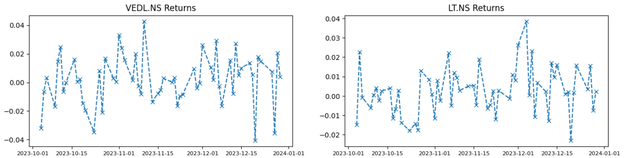
Returns Plots

Slide 7
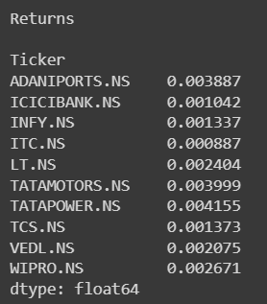
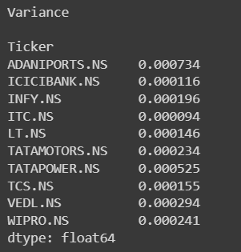
Expected return and risk measures for each risky asset.
Returns and Risk(Variance) of each asset are :-

Slide 8

Derived Portfolio Optimization
Created a derived portfolio for the 10-risky assets chosen.
Optimized the derived portfolio with given returns and their risks.
Plotted Markowitz Curve, bullet, efficient frontier similar to what we have done in project 2.
Used this to plot the Capital Market Line (CML) and in proving the point of tangency.

Slide 9
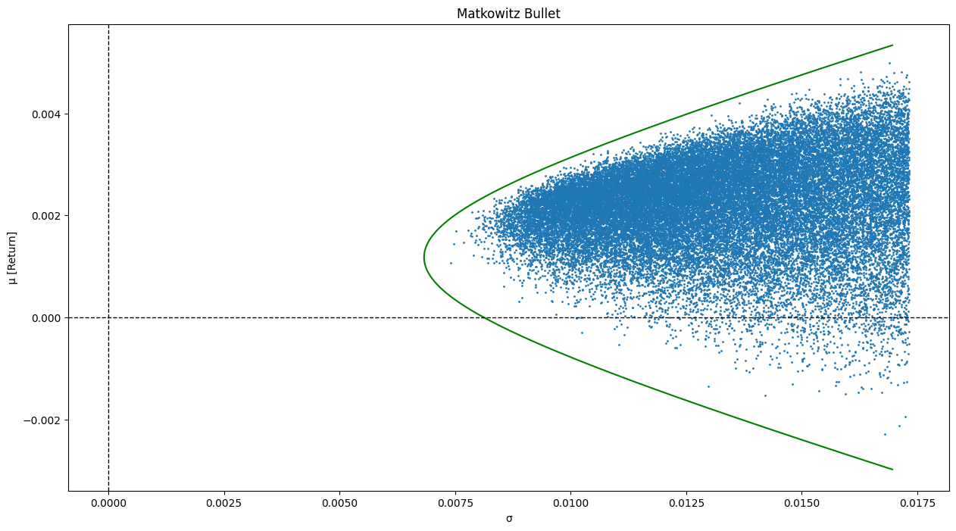
Markowitz Bullet
It is the graph between 𝞂, and returns(𝝻) plotted when we try to minimize the risk associated with the expected returns.

Slide 10
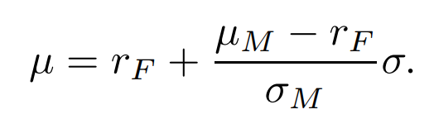
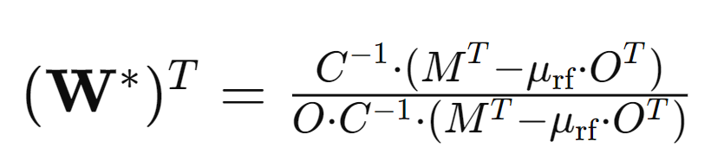
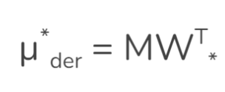
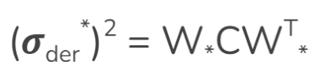
Capital Market Line (CML)
For drawing CML, we need to maximize the slope between the graph return and volatility(standard deviation).
We get optimal derived weights by solving the maximization problem, by this weight we can get derived return and derived volatility.
Here M is the vector of expected returns of risky assets.

Slide 11
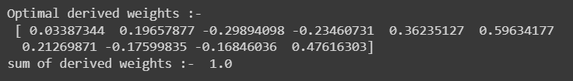


Capital Market Line (CML)
On solving the optimization problem we get the relation between return and volatility, which incorporates the risk free asset as well.
The results are :-

Slide 12
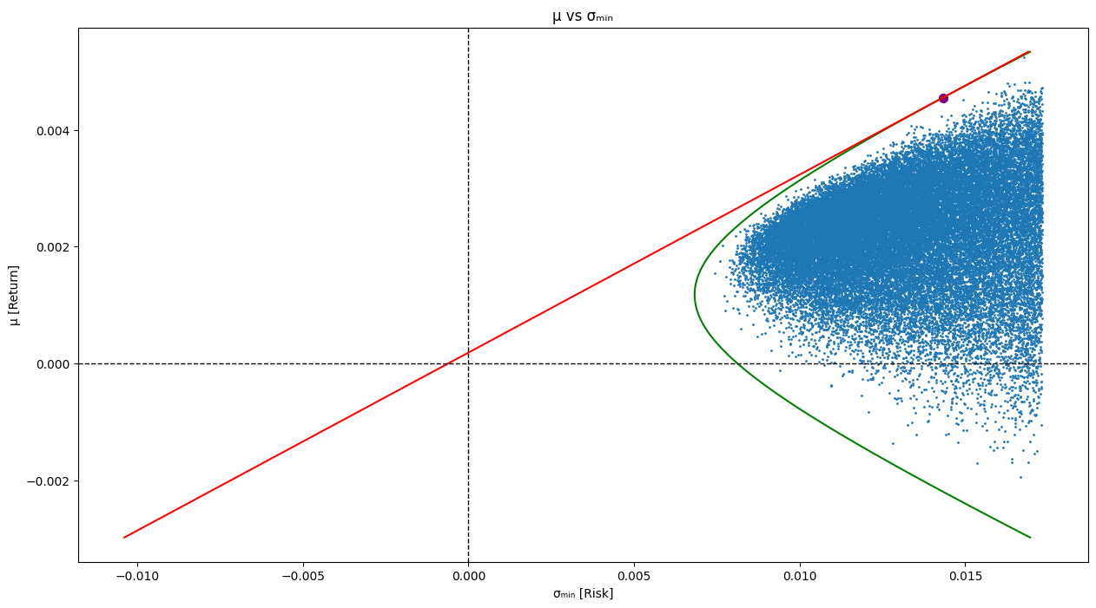
Capital Market Line (CML)

Slide 13
Significance of tangency | CML
The point obtained on the markowitz bullet i.e. derived expected return and derived volatility, and the CML line which joins risk free rate and this point is tangent to the bullet.
The tangency portfolio is the point of maximum Sharpe ratio, which is a measure of risk-adjusted performance.
This portfolio is considered the best choice for investors who are risk-averse and want to optimize their portfolio's performance by balancing risk and return.
Investors can choose a combination of the tangency portfolio and the risk-free asset to tailor their portfolio to their risk preferences.

Slide 14
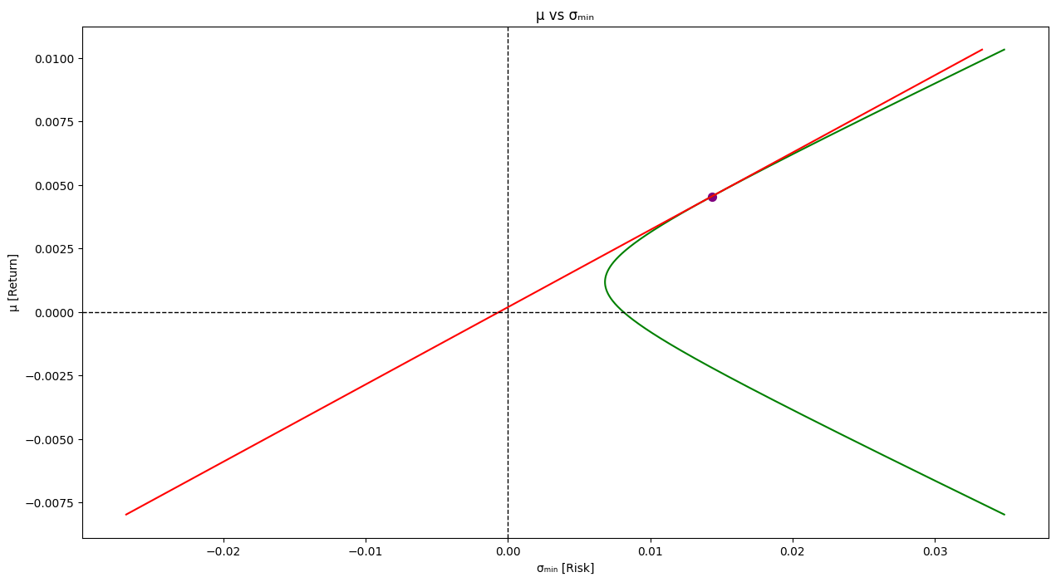

Significance of tangency | Validation

Slide 15

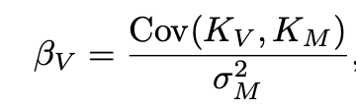
Security market lines (SML)
SML is an investment evaluation tool derived from CAPM that works on the principle that investor should be compensated for both the time value of money (TVM) and corresponding risk associated with the investment (risk premium).
Beta is the measure of volatility or systematic risk of an asset or a portfolio compared to the market.
An asset can be classified as undervalued or overvalued based on its level of systematic risk, compared to the market.
If an asset is plotted above the security market line, it is underpriced. If an asset is plotted below, it is overpriced.

Slide 16
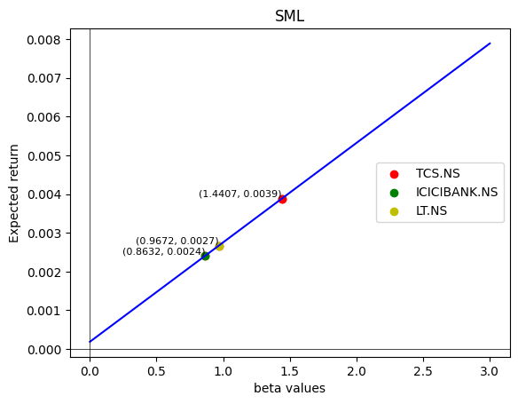
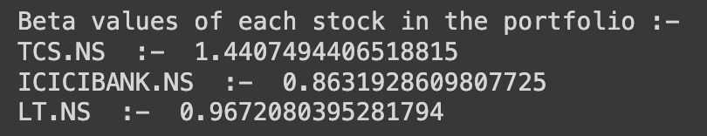
Security Market Lines (𝝻_{k}-beta line)
The market consists a portfolio of 3 assets.
SML is plotted between U_{k} and beta:
Slope = (U_{M} - U_{rf})
Intercept = U_{rf}
Points corresponding to individual assets are plotted on SML line by calculating their beta values.

Slide 17
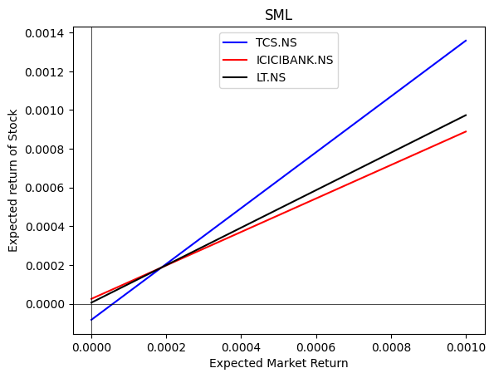
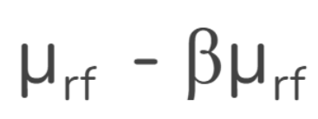
Security Market Lines (𝝻_{k}- 𝝻_{M} line)
The market consists of a portfolio of 3 assets.
SML is plotted between μ_{k} and μ_{M}:
Slope = Beta of individual assets
Intercept =
SML corresponding to individual assets are plotted by calculating their beta values.
Point of intersection shows point of equal expected market and stock returns due to some specific sets of weights for these stocks in the portfolio.

Slide 18


Sharpe Ratio
The capital market line joining the risk-free security and the market portfolio satisfies the equation .
Sharpe ratio is defined as the difference between the returns of the investment and the risk-free return, divided by the standard deviation of the investment returns v.i.z slope of the capital market line (CML).

Slide 19
Sharpe Ratio
A higher Sharpe Ratio indicates a better risk-adjusted performance.
It helps investors assess if the additional return earned by a portfolio is worth the additional risk taken.
Comparing Sharpe Ratios among different portfolios allows for a more informed decision on which portfolio provides a better risk-return trade-off.
Sharpe ratio of individual assets can also be compared with overall performance of a portfolio.
A higher Sharpe Ratio generally signifies better risk-adjusted performance. This can enhance investor confidence, attracting those who are risk-averse or looking for a more stable investment strategy.

Slide 20
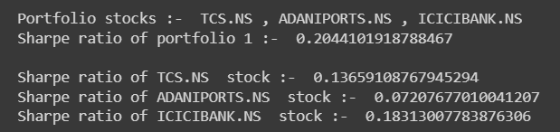
Comparison of sharpe ratio
We have created various portfolios for comparing the sharpe ratios.
This portfolio has a moderate overall Sharpe ratio, indicating a reasonable balance between risk and return. While ICICI BANK contributes positively to the portfolio's risk-adjusted return, the lower individual Sharpe ratios of TCS and ADANI PORTS temper the overall performance.

Slide 21
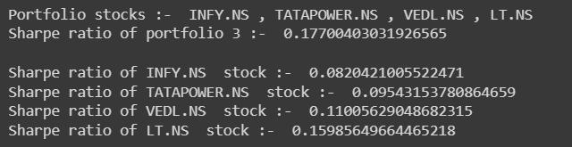
Comparison of sharpe ratio
The overall portfolio demonstrates a positive risk-adjusted return, with LT and VEDL contributing more significantly to the portfolio's performance.
The individual Sharpe ratios suggest that LT has the highest risk-adjusted return, followed by VEDL, TATAPOWER, and INFY.
The diversification across different sectors (information technology, power, metals, and infrastructure) may contribute to spreading the risk within the portfolio.
Portfolio 1 has a higher overall Sharpe ratio (0.2044) compared to Portfolio 2 (0.1770).
This suggests that, on a risk-adjusted basis, Portfolio 1 has a better performance relative to Portfolio 3.

Slide 22
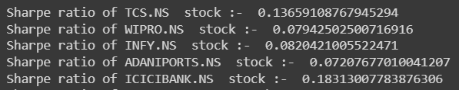
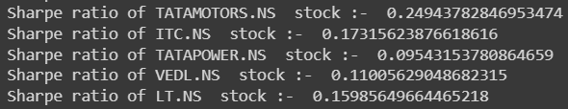
Comparison of sharpe ratio
Here we have compared the sharpe ratios of all 10 stocks in the portfolio.
The sharpe ratio of the portfolio is 0.3044
TATAMOTORS.NS has the highest individual Sharpe ratio, suggesting strong risk-adjusted performance.
ICICIBANK.NS and LT.NS also have relatively high Sharpe ratios, indicating favorable risk-return profiles.
ADANIPORTS.NS has a lower Sharpe ratio, implying higher risk compared to some other stocks in the portfolio.
Stocks with higher individual Sharpe ratios, such as TATA MOTORS.NS, ICICIBANK.NS, and LT.NS, contribute more positively to the overall portfolio return. These stocks offer better risk-adjusted returns.

Slide 23
Markowitz vs CAPM | Bonus
The Capital Asset Pricing Model (CAPM) provides a solution that is much more efficient computationally, does not involve an estimate of C, but offers a deep, even if somewhat oversimplified, insight into some fundamental economic issues.
CAPM is based on CML and SML where as Markowitz optimization is based on efficient frontier v.i.z the set of efficient portfolios among all attainable portfolios.
Markowitz theory considers only risky assets where as CAPM has the inclusion of risk-free assets.
For risk analysis, MPT uses standard deviation (or variance) to measure risk, CAPM uses beta, representing systematic risk.
Systematic risk, also known as market risk or undiversifiable risk, is the inherent risk associated with the entire market or a particular segment of it. This type of risk cannot be eliminated through diversification because it affects all assets in the market.
Systematic risk is caused by external factors that impact the overall economy, financial markets, and various industries.

Slide 24
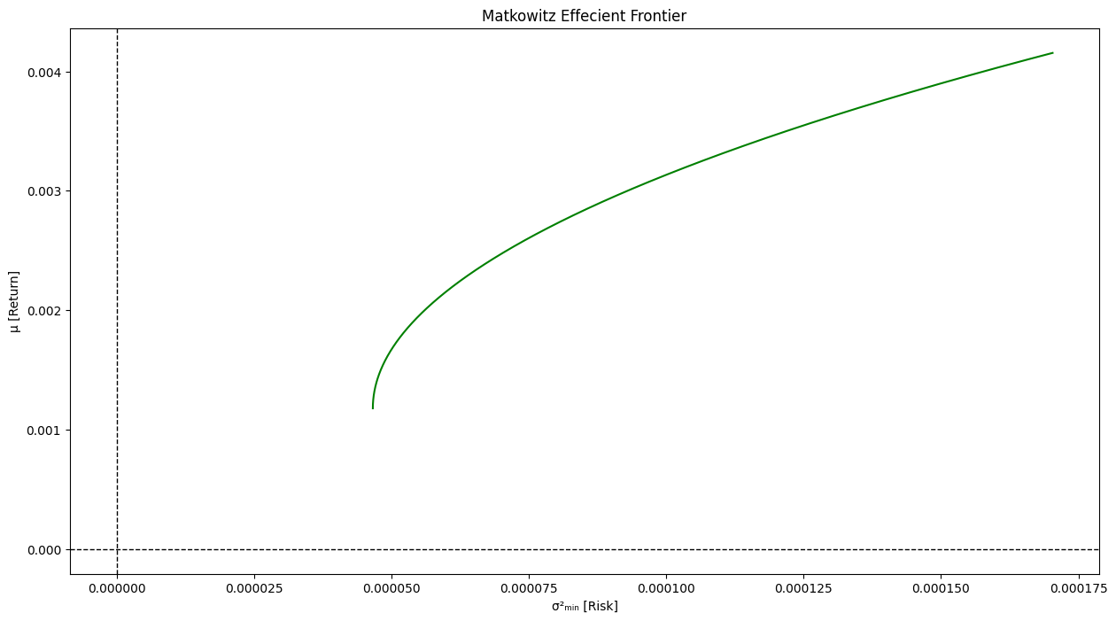
Portfolio Comparison | Bonus
Efficient Frontier
CAPM

Slide 25
Key Insights | Bonus
Markowitz:
Diversification is key to reducing portfolio risk without sacrificing returns.
The efficient frontier shows the optimal trade-off between risk and return for different investors.
CAPM:
Systematic risk is a key determinant of expected returns.
Portfolios can be constructed to align with an investor's risk preferences by adjusting the weights of assets with different betas.
Markowitz is better for:
Building personalized portfolios based on individual risk tolerance.
Capturing the benefits of diversification within a portfolio.
CAPM is better for:
Getting a quick estimate of an asset's expected return based on market risk.
Understanding the impact of systematic risk on portfolio performance.

Slide 26
Thank You
Group Members (Group -07) :-
Chennamsetty Ushakiran (B20MT014)
Saurabh Kumar (B20CS062)
Shubham Kumar (B20CS069)
Tanisha Jain (B20CS093)

